Slide 1

Banking CRM Churn Analysis
P.SUNNYHITHA

Slide 2
AGENDA
PROBLEM STATEMENT
DATABASE SCHEMA
MARKETING STRATEGIES
DATA OVERVIEW
KEY METRICS & INSIGHTS
CONCLUSION

Slide 3

PROBLEM STATEMENT
The bank is facing a significant challenge in retaining customers, with a notable percentage of customers exiting over time.
The objective of this analysis is to identify key factors contributing to customer churn and understand customer behavior using CRM data. This will help the bank improve customer retention, enhance service delivery, and make data-driven business decisions.

Slide 4
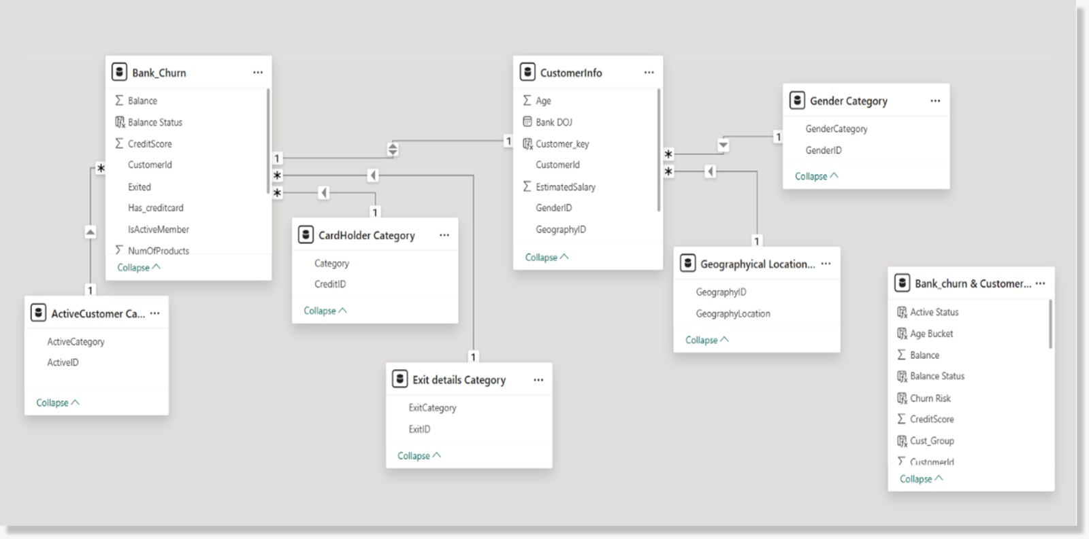
DATA OVERVIEW

Slide 5
DATA SET OVERVIEW
Multiple datasets were combined and transformed into a single structured dataset using Excel Power Query.
The dataset consists of key features such as:
Customer demographic information (age, gender, location)
Banking details (tenure, balance, product usage)
Financial indicators (credit score, salary)
Customer activity and credit card status
Churn-related data representing exited and retained customers

Slide 6
WORKFLOW
Data Collection from multiple source tables
Data Cleaning and Preprocessing using Excel Power Query
Data Integration by merging datasets into a master dataset
Data Storage and Analysis using SQL
Data Visualization using Power BI dashboards
Insight Generation for business decision-making

Slide 7

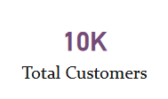
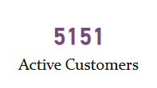
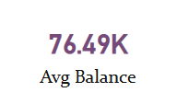
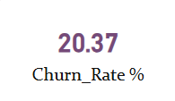
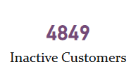
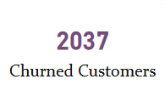
BUSINESS PERFORMANCE METRICS

Slide 8
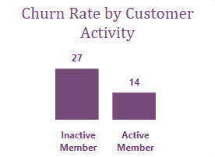
CUSTOMER CHURN BASED ON ACTIVITY STATUS
Customers who are inactive show a churn rate of 26.85%, while active customers have a lower churn rate of 14.27%.
Inactive customers are almost twice as likely to churn compared to active customers. This indicates that customer engagement plays a major role in retention.
Customer inactivity significantly increases the likelihood of churn.

Slide 9
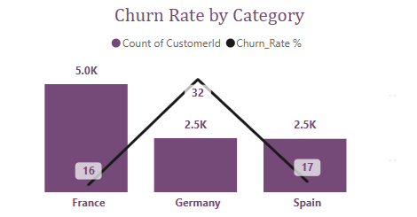
CUSTOMER CHURN ACROSS REGIONS
Customer churn is highest in Germany at 32.44%, while Spain (16.67%) and France (16.15%) have much lower churn rates.
Germany has fewer customers (2.5K) but still shows high churn, making it a critical region to focus on.
France has the highest number of customers (5K) and a lower churn rate, suggesting stronger customer retention.
Churn is highest in Germany, making it a key region for retention focus.

Slide 10
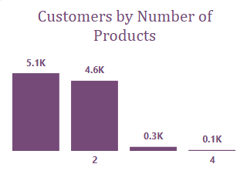
CUSTOMER DISTRIBUTION BY NUMBER OF PRODUCTS
Most customers are using 1 or 2 products, with very few customers using 3 or more products.
The customer base is heavily concentrated in lower product categories.
This indicates limited product adoption among customers.
Customer base is concentrated in low product usage segments.

Slide 11
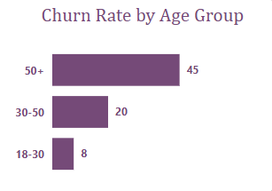
CUSTOMER RATE BY AGE GROUP
The 50+ age group has the highest churn rate (44.65%), followed by 30–50 (19.58%) and 18–30 (7.52%).
Younger customers show significantly lower churn compared to older customers. This suggests that older customers are more prone to leaving the bank.
Older customers are more likely to churn compared to younger age groups.

Slide 12
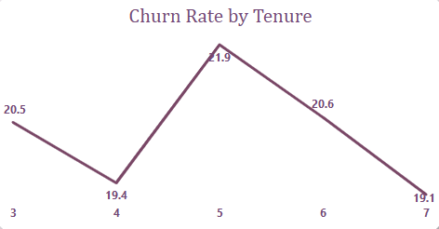
CUSTOMER CHURN ACROSS TENURE
The highest churn rate is observed at tenure 5 (21.91%), followed by tenure 6 (20.57%) and 3 (20.47%).
Churn rates are slightly lower at tenure 4 (19.35%) and 7 (19.14%).
This shows that churn varies across tenure but does not follow a consistent increasing or decreasing trend.
Customer churn does not show a consistent pattern across tenure.

Slide 13
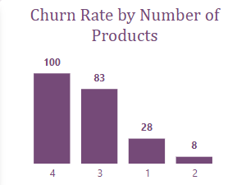
CUSTOMER CHURN ACROSS PRODUCT USAGE
Customers using 1 product have a higher churn rate (27.71%) compared to those using 2 products (7.58%).
Churn appears very high for customers with 3 and 4 products, but these groups are relatively small.
Customers with more than one product tend to stay longer, showing that higher product usage reduces churn.
Lower product usage leads to higher churn, whereas multiple products improve retention.

Slide 14
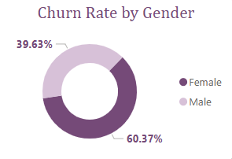
CUSTOMER CHURN BY GENDER
Churn is higher among female customers (60.37%) compared to male customers (39.63%).
There is a clear gap in churn between the two groups.
This shows that customer behavior differs across gender segments.
Churn is higher among female customers than male customers.

Slide 15
CUSTOMER RETENTION & GROWTH STRATEGIES
RETENTION STRATEGY
PRODUCT STRATEGY
ENGAGEMENT STRATEGY
Target inactive customers, as they show higher churn (26.85% vs 14.27% for active users).
Focus on high-risk regions like Germany, which has the highest churn (32.44%).
Retain customers with low product usage, especially those with 1 product (27.71% churn).
Encourage customers to adopt multiple products, as churn drops significantly (27.71% to 7.58%).
Promote bundled services to increase engagement and long-term retention.
Identify and upsell customers with low product usage.
Focus on older customers (50+ with 44.65% churn) through targeted communication.
Improve customer activity levels to reduce inactivity-driven churn.
Strengthen engagement strategies across key customer segments.

Slide 16
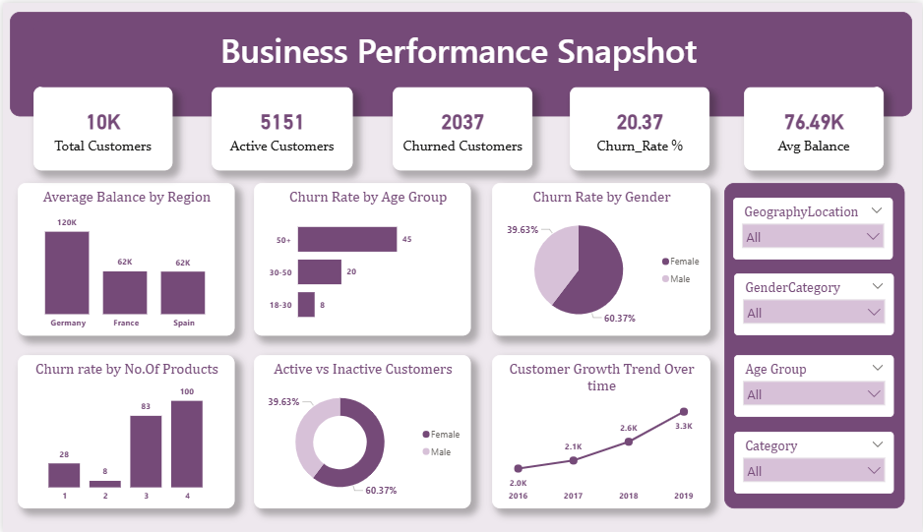
DASHBOARD -1

Slide 17
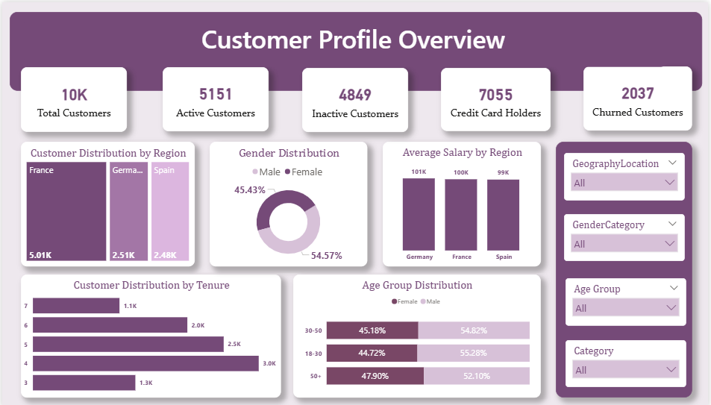
DASHBOARD -2

Slide 18
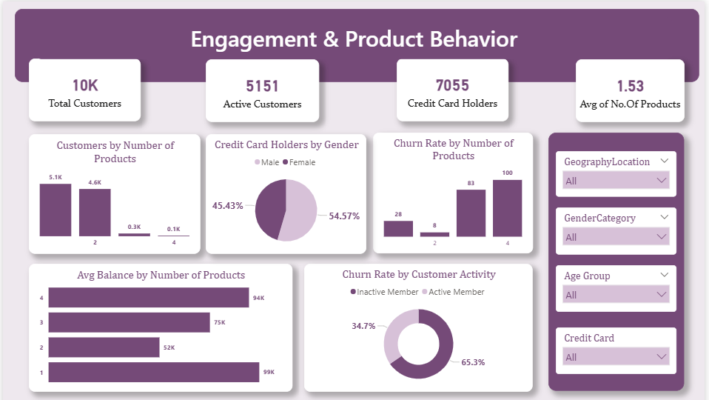
DASHBOARD -3

Slide 19
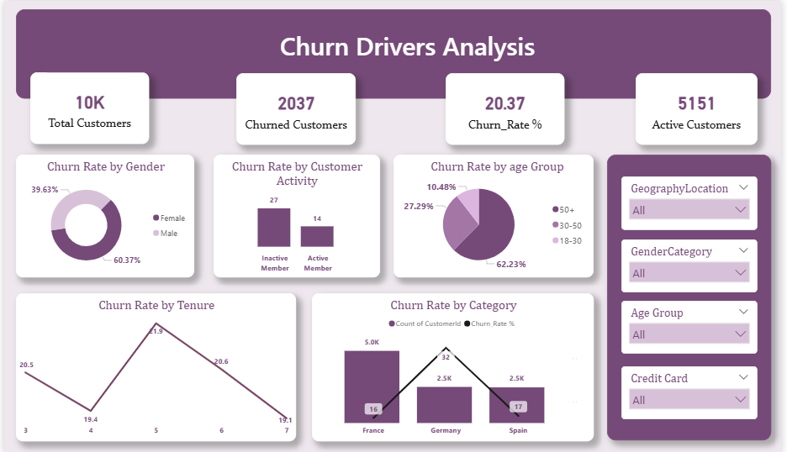
DASHBOARD -4

Slide 20

CUSTOMER RETENTION STRATEGIES
Re-engage inactive customers, as they are more likely to churn than active users.
Focus on high-risk regions like Germany where churn is significantly higher.
Promote the use of multiple products to improve customer retention.
Pay attention to older customers who show higher churn rates.
Improve customer engagement to reduce inactivity.
Identify and manage high-risk customer segments effectively.

Slide 21

KEY FINDINGS & CONCLUSION
Customer churn is driven by low engagement, fewer products, and certain customer segments.
Inactive customers and single-product users are more likely to leave.
Germany and older customers show higher churn levels.
Improving engagement and product usage can help retain customers.
Data analysis helps in making better business decisions.

Slide 22


